Slide 1
Inheritance

Slide 2
Type of association between objects:
IS-A or Kind-of
Also known as Generalization or Specialization
HAS-A or Part-of or contains-of
Also known as Aggregation or Containership

Slide 3
IS-A (Inheritance)
Inheritance represents the IS-A relationship, also known as parent-child relationship.
Inheritance is a mechanism in which one object acquires some of the properties and behaviours of parent object.
The idea behind inheritance is that you can create new classes that are built upon existing classes.
When you inherit from an existing class, you can reuse methods and fields of parent class, and you can add new methods and fields also.

Slide 4
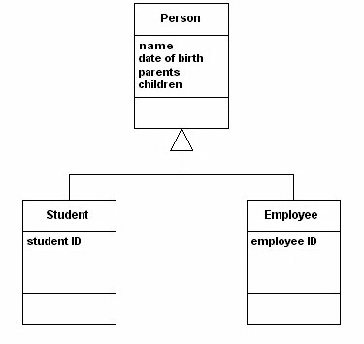
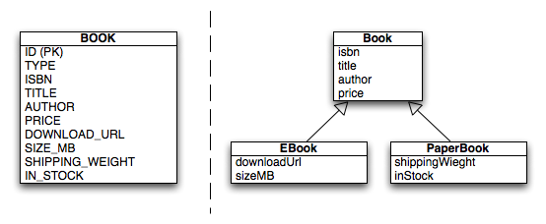
Example: Inheritance

Slide 5
HAS-A (Aggregation)
If a class contains an object of other class, it is known as Aggregation. Aggregation represents HAS-A relationship.
It is a special form of Association where:
It represents Has-A relationship.
It is a unidirectional association i.e. a one way relationship. For example, department can have students but vice versa is not possible and thus unidirectional in nature.
In Aggregation, both the entries can survive individually which means ending one entity will not effect the other entity

Slide 6
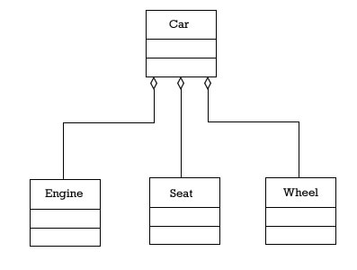
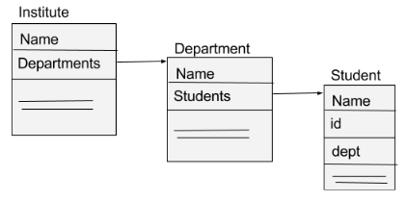
Example: Aggregation

Slide 7
Why Inheritance and Aggregation
Why use inheritance
For Method Overriding (so runtime polymorphism can be achieved).
For Code Reusability.
Reuse is also best achieved by aggregation when there is no is-a relationship.

Slide 8
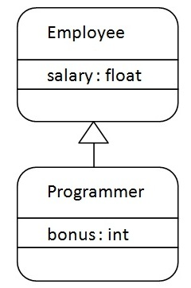
Toy Examples in Java
class Subclass-name extends Superclass-name
{
//methods and fields
}

Slide 9
class Employee{
float salary=40000;
}
class Programmer extends Employee{
int bonus=10000;
public static void main(String args[]){
Programmer p=new Programmer();
System.out.println("Programmer salary is:"+p.salary);
System.out.println("Bonus of Programmer is:"+p.bonus);
}
}
Output:
Programmer salary is:40000.0
Bonus of programmer is:10000

Slide 10
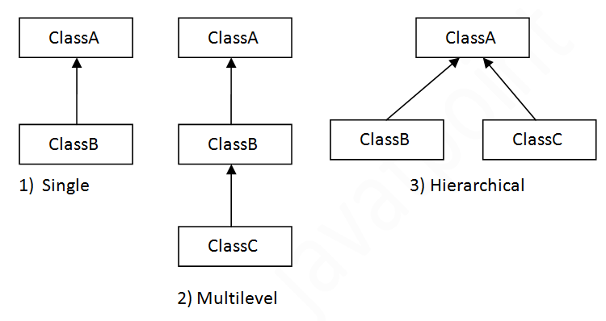
Types of Inheritance

Slide 11
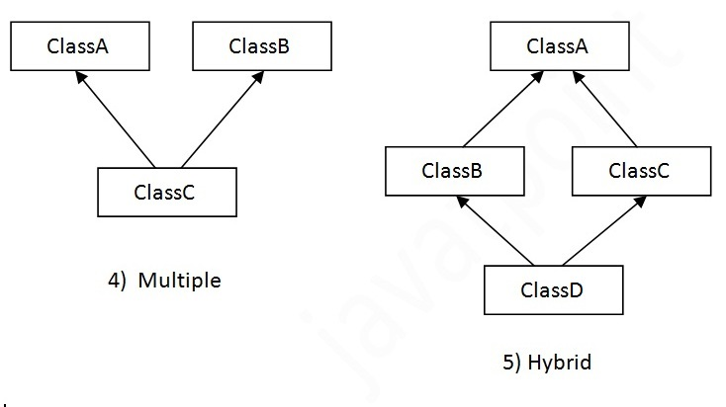
Types of Inheritance…Contd

Slide 12
Single Inheritance Example
class Animal
{ void eat()
{
System.out.println("eating...");
}
}
class Dog extends Animal
{
void bark(){System.out.println("barking..."); //eat(); }
}
class TestInheritance
{
public static void main(String args[])
{
Dog d=new Dog();
d.bark();
d.eat();
}
}
Output:
barking...
eating...

Slide 13
Aggregation Example
public class Address
{
String city,state,country;
public Address(String city, String state, String country)
{
this.city = city;
this.state = state;
this.country = country;
}
}

Slide 14
public class Emp
{
int id;
String name;
Address address;
public Emp(int id, String name,Address address)
{
this.id = id;
this.name = name;
this.address=address;
}
void display()
{
System.out.println(id+" "+name);
System.out.println(address.city+" "+address.state+" “
+address.country);
}
}

Slide 15
class Test
{
public static void main(String[] args)
{
Address address1=new Address("gzb","UP","india");
Address address2=new Address("gno","UP","india");
Emp e=new Emp(111,"varun",address1);
Emp e2=new Emp(112,"arun",address2);
e.display();
e2.display();
}
}

Slide 16
Design a discount system for a beauty saloon, which provides services and sells beauty products. It offers 3 types of memberships: Premium, Gold and Silver. Premium, gold and silver members receive a discount of 20%, 15%, and 10%, respectively, for all services provided.
Customers without membership receive no discount. All members receives a flat 10% discount on products purchased (this might change in future).
Identify the classes.
Your System shall compute the total bill if a customer purchases $x of products and $y of services, for a visit. Also write a test program to exercise all the classes.

Slide 17
A shopping mall has four types of employees and their pay structure is given below:
Salaried employees are paid a fixed weekly salary regardless of the number of hours worked. Hourly employees are paid by the hour and receive overtime pay for all hours worked in excess of 40 hours. Commission employees are paid a percentage of their sales. Salaried-commission employees receive a base salary plus a percentage of their sales.
For the current pay period, the shopping mall has decided to reward salaried-commission employees by adding 10% to their base salaries. Develop a Java class hierarchy for the given case study:

